Slide 1


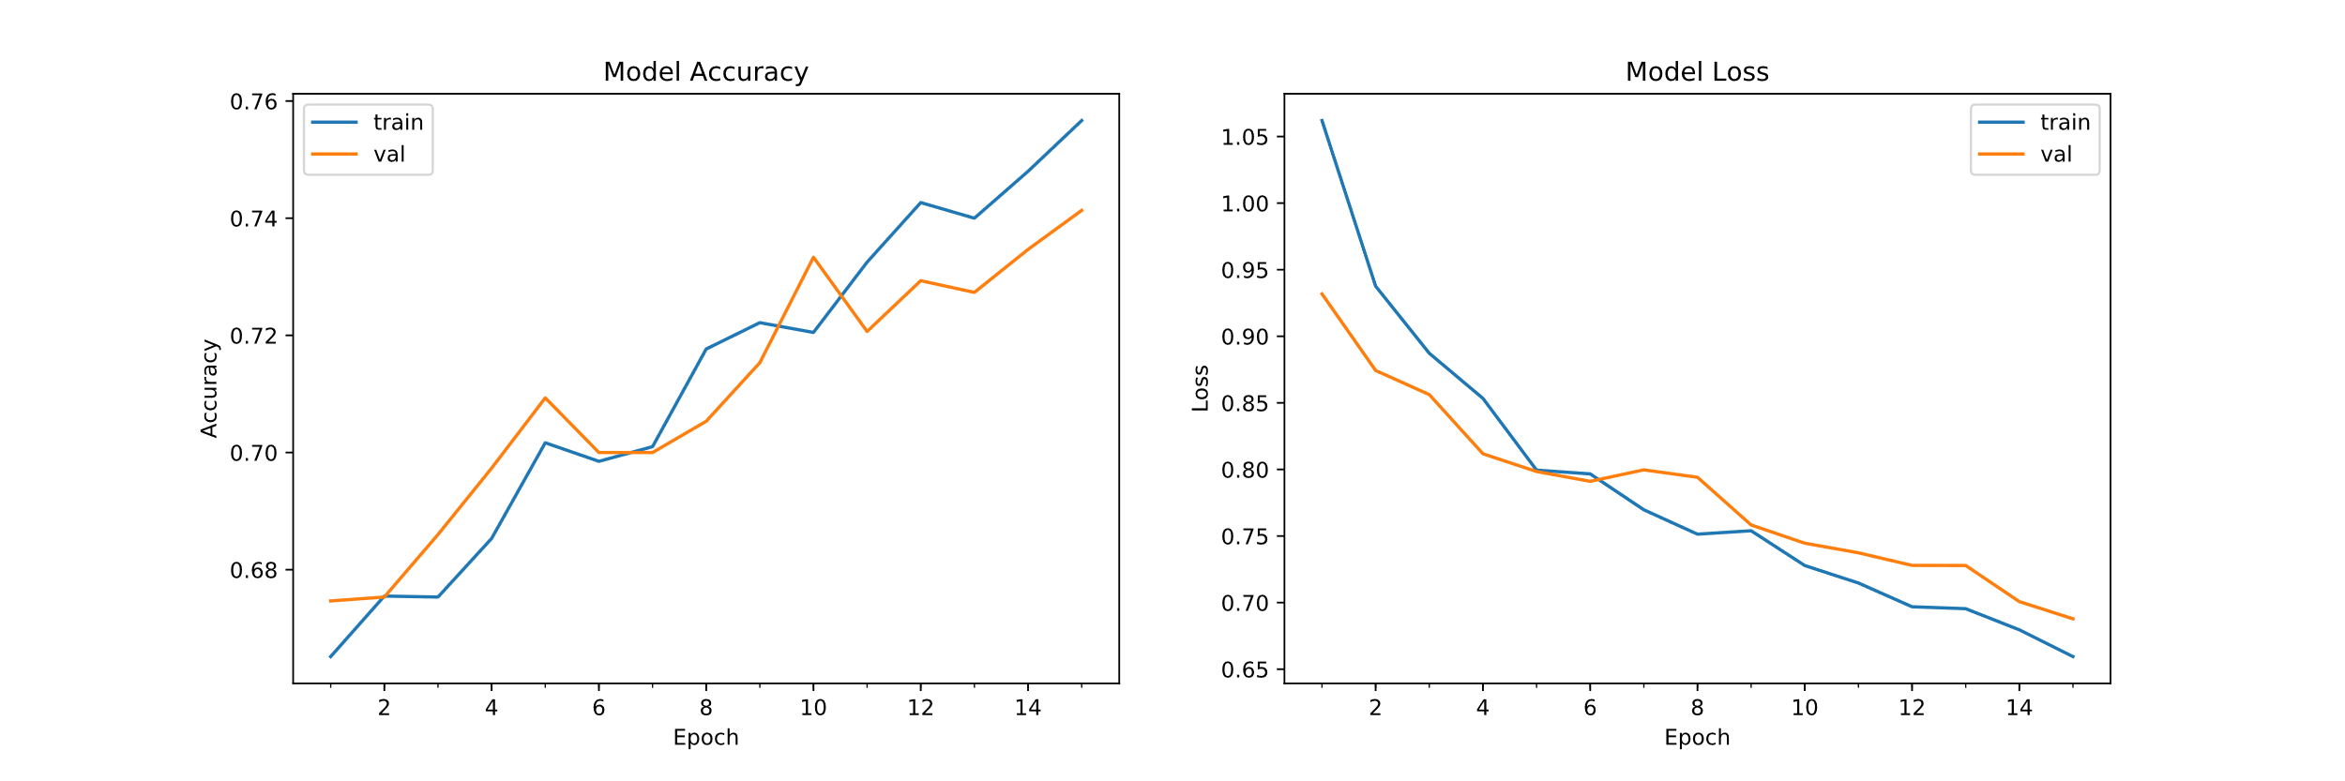
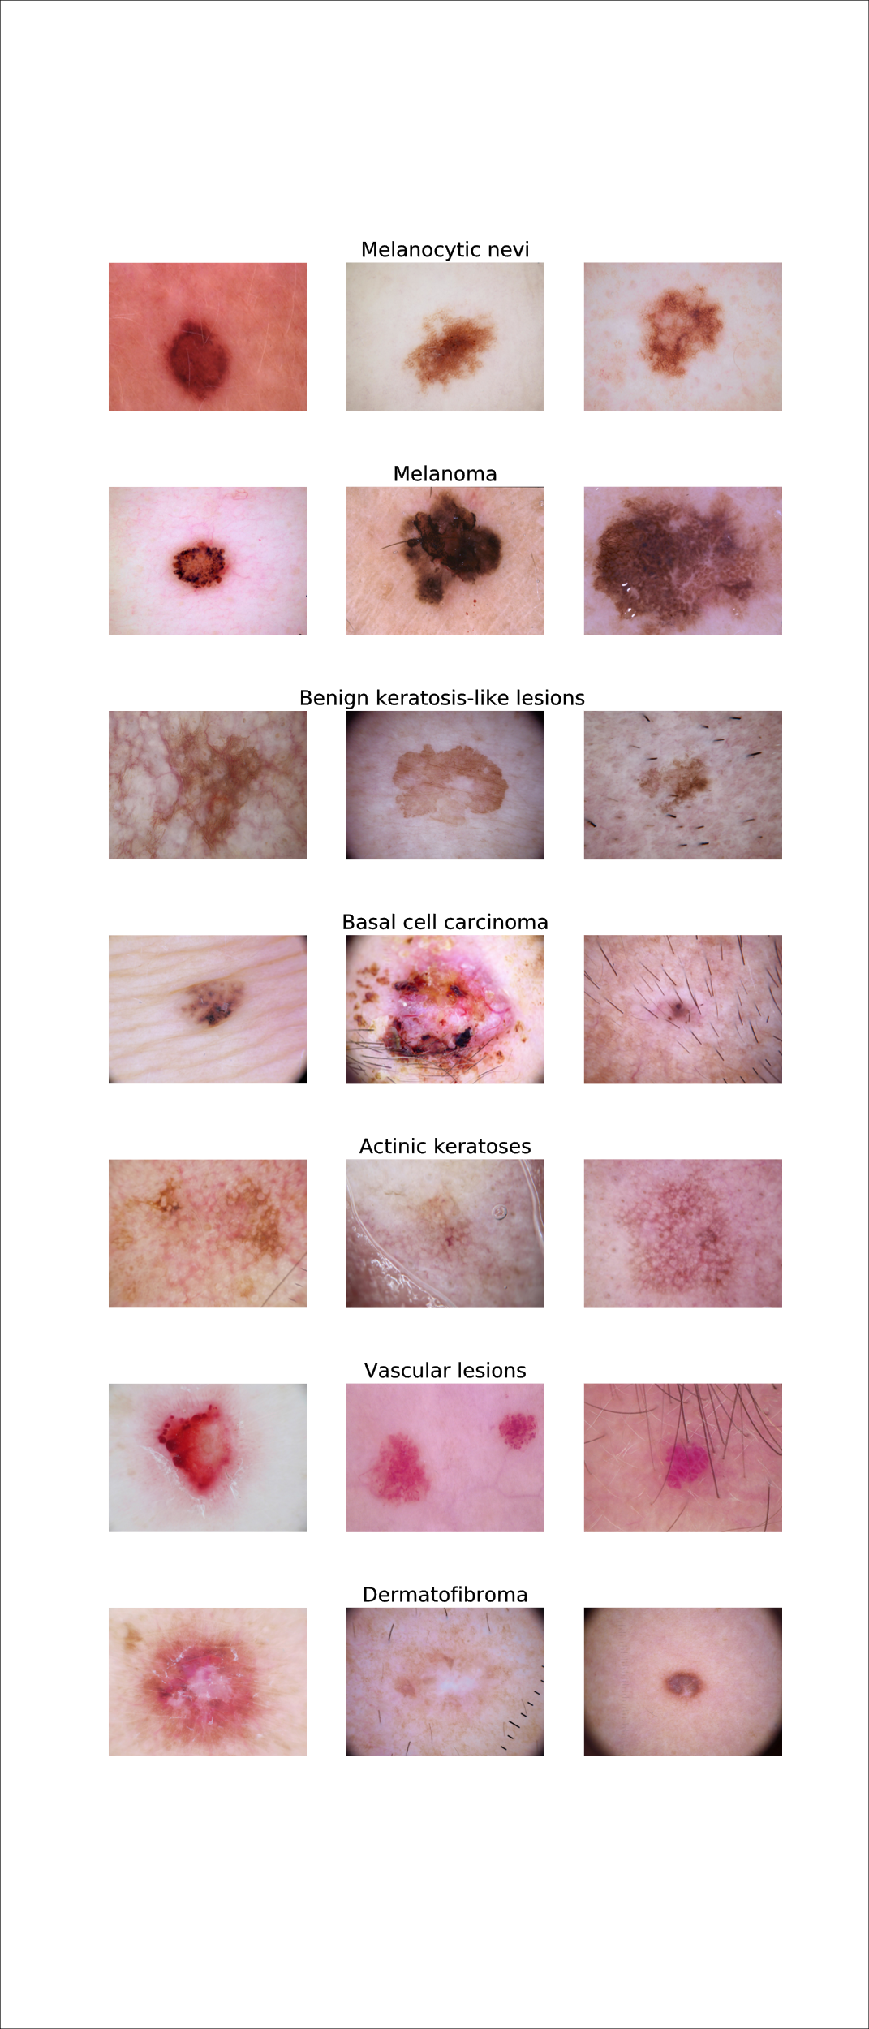
Skin Cancer Detection Kenny Luu kepluu@ucsc.edu Sinclair Liang kepluu@ucsc.edu
Abstract
The types of lesions
These are some samples of the different types of lesions we're looking at in the dataset. Most of the different types of skin lesions in this dataset are either cancerous or pre-cancerous although some a just benign.
Melanocytic Nevi - A usually noncancerous disorder of pigment-producing skin cells commonly called birth marks or moles
Melanoma - One of the most serious types of skin cancer
Benign Keratosis-like Lesions - A harmless growth on the skin
Basal Cell Carcinoma - A type of cancer that arises due to sun exposure
Actinic Keratosis - A scaly growth caused by damage from exposure to the sun, the most common type of precancerous skin lesion
Vascular Lesions - Comprise of all skin disease that originate from or affect blood, including malignant or benign tumors
Dermatofibroma - A benign growth of the skin
Figure 1.
Results
The differentiation and identification of cancerous skin lesions is usually done through histopathology, a microscopic examination of the suspect tissue. What we wanted to achieve was an accurate model which can discern from seven different types of cancerous and non-cancerous skin lesions from an image of the skin lesion. We achieve this through the use of convolutional neural networks.
Introduction
Skin cancer is one of the most common human cancers. Skin cancers are usually diagnosed by initial clinical screening then followed by a confirmatory examination. By developing AI algorithm to automate some parts of the process, it can take some of the burden off from our medical professionals’ shoulders.
The dataset from which we trained our model on contained 10,015 images, each of which represented one of seven different types of skin lesions. This dataset also contained meta information about the images which included: age, sex, localization of the lesion, and the method of determination of the type of lesion.
After training out model, we achieved 75.67% accuracy.
Methodologies
Model Building:
Sources
"A Beginner's Guide To Convolutional Neural Networks (Cnns)". Skymind, 2019, https://skymind.ai/wiki/convolutional-network.

